Slide 1
Induction 2022-23

Slide 2
The Partnership is a result of a collaborative agreement and approach to safeguarding from multi-agency partners involved with children and / or adults.
The responsibility for safeguarding sits with the three statutory partners. They are:
South Tyneside Council
NHS North East and North Cumbria Integrated Care Board
Northumbria Police
Hello and welcome to the South Tyneside Safeguarding Children and Adults Partnership

Slide 3
The Aim of the Partnership
The aim of the Partnership is to;
Work together to safeguard and promote the safety and wellbeing of children and adults at risk of harm or abuse, including identifying and responding to their needs.
Undertake the statutory safeguarding duties assigned to children and adults
Increase the focus on improving practice across children and adults
Strengthen the Think Family model across the partnership

Slide 4
The Legislative Framework / Guidance
Working Together to Safeguard Children Guidance 2018 and the Care Act 2014 both set out requirements for all local safeguarding partners to work together to safeguard and promote the safety and wellbeing of local children and adults at risk of harm or abuse, including identifying and responding to their needs.

Slide 5
The Statutory Functions of the Partnership
Undertake statutory reviews which include:
Child Safeguarding Practice Reviews ( CSPR’s)
Safeguarding Adult’s Reviews (SAR’s)
Publish an annual report
Publish an annual strategic plan ( adults)

Slide 6
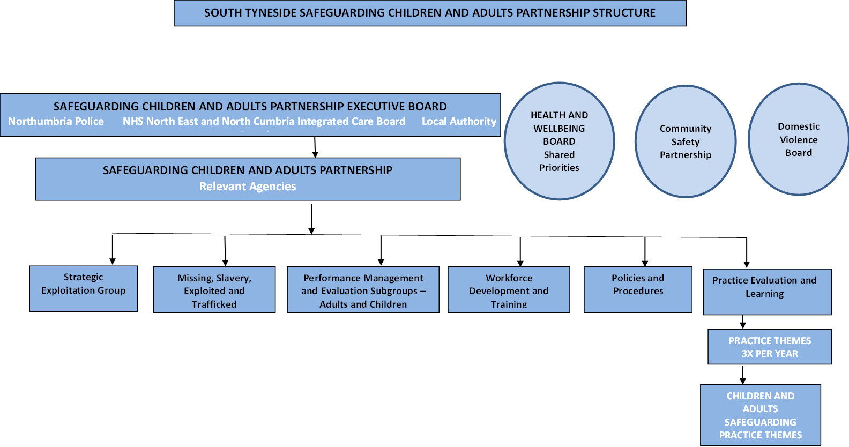
The Structure of the Partnership

Slide 7
Independent Scrutiny
One key change for the local safeguarding partners is the way in which independent oversight of the arrangements is gained.
The appointment of an Independent Scrutineer in November 2020 has allowed for further discussions and development of a role that has started to tentatively challenge and hold partners to account for their delivery of services that safeguard everyone.
The Independent Scrutineer is Richard Burrows.

Slide 8
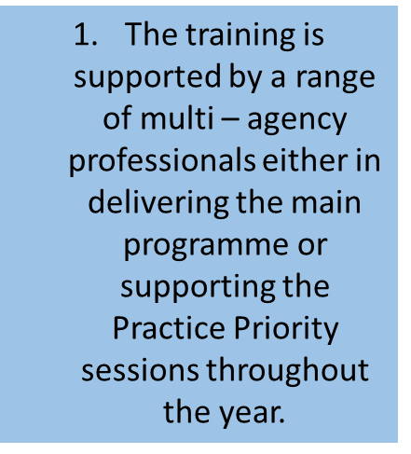
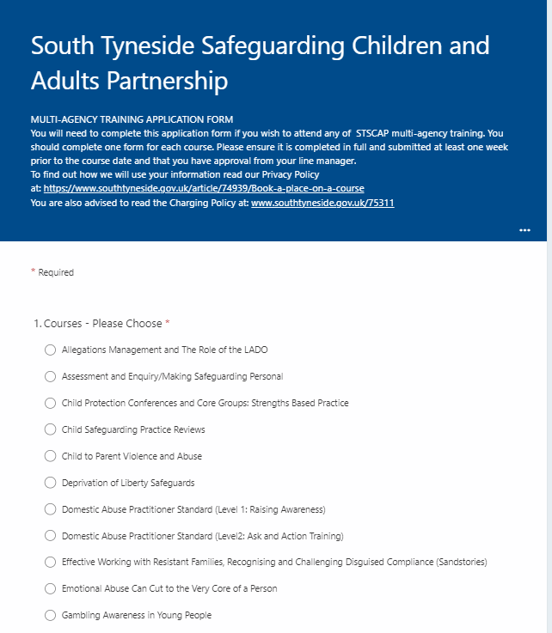
We have an online application and evaluation process

Slide 9
What do the certain elements of the Partnership do?
South Tyneside Safeguarding Children and Adults Partnership Executive
Undertakes the overall safeguarding responsibility, statutory and strategic function and oversees the Safeguarding Children and Adults Practice Partnership
Partnership
To strengthen the focus on practice ensuring a direct link with practitioners to influence and fully understand frontline practice from both a practitioner and child and adult perspective
Practice Evaluation and Learning Subgroup
Make the recommendation to the Executive Board to undertake Safeguarding Rapid Reviews, Child Safeguarding Practice Reviews or Safeguarding Adult Reviews in line with national guidance
Performance Management and Evaluation Subgroups (children and adults)
Receive, monitor and analyse multi-agency safeguarding reporting and statutory returns which will inform the Partnership with additional information for further consideration
Missing, Slavery, Exploited and Trafficked (MSET)
The Pre-MSET and MSET subgroups are responsible for coordinating and ensuring the effectiveness of arrangements to safeguard and promote the safety and wellbeing of children, young people and adults who go missing and/or at risk of slavery, exploitation or trafficking
Workforce Development and Training
Planning, implementation, commissioning and evaluation of the joint multi-agency training and e-learning programme
Policies and Procedures
Develop and maintain up to date multi-agency policies and procedures for safeguarding and promoting the welfare of children and young people and adults in South Tyneside

Slide 10
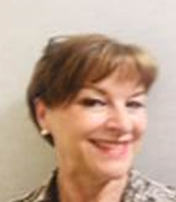
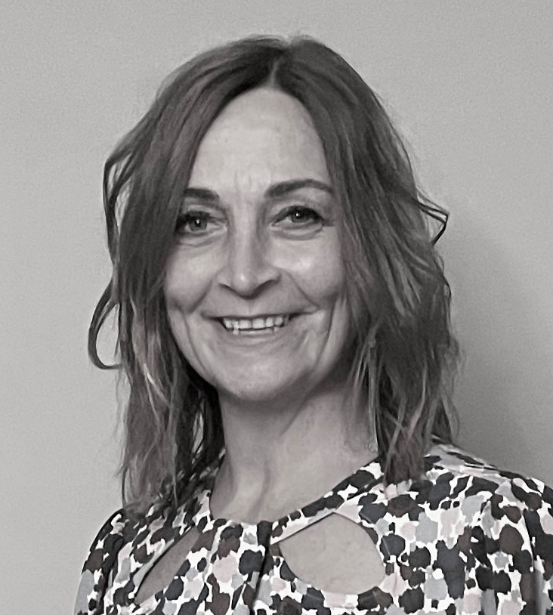
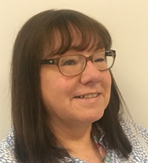
Meet the Team
Jackie Nolan – Business Manager for the Partnership
Role to ensure all statutory functions addressed and co-ordinate the work of the Partnership. jacqueline.Nolan@southtyneside.gov.uk
Leah Collinson – Safeguarding Development Officer
Role to support the Business Manager function and develop the day to day work of the partnership including engagement with local, regional and national networks.
leah.Collinson@southtyneside.gov.uk
Lynn Hodson – Business Support Officer
Role to support the STSCAP Business and the wider Partnership members with all aspect of administration
lynn.Hodson@southtyneside.gov.uk

Slide 11
For Children Contact the Integrated Safeguarding Interventions Team (ISIT) 0191 4245010
For Adults - Let’s Talk Team
0191 4246000
Out of Hours Team
0191 4562093
Care Quality Commission (CQC):
03000 61 61 61
Police:
999 or 101
Useful Contacts

Slide 12
Additional Information
Website
https://www.southtyneside.gov.uk/article/35807/Worried-about-a-child-
Safeguarding Policies and Procedures
Children
https://www.proceduresonline.com/nesubregion/
Adults
https://www.southtynesidesafeguardingappp.co.uk/

Slide 13
Glossary of Terms / Abbreviations

